Slide 1
Logic Programming Languages
BBM 301 – Programming Languages

Slide 2
Introduction
Programs in logic languages are expressed in a form of symbolic logic
Use a logical inferencing process to produce results
Declarative rather that procedural:
  Only specification of results are stated (not detailed procedures for producing them)

Slide 3
Proposition
A logical statement that may or may not be true
  Consists of objects and relationships of objects to each other

Slide 4
Symbolic Logic
Logic which can be used for the basic needs of formal logic:
  Express propositions
  Express relationships between propositions
  Describe how new propositions can be inferred from other propositions
Particular form of symbolic logic used for logic programming called predicate calculus

Slide 5
Object Representation
Objects in propositions are represented by simple terms: either constants or variables
Constant: a symbol that represents an object
Variable: a symbol that can represent different objects at different times
  Different from variables in imperative languages

Slide 6
Compound Terms
Atomic propositions consist of compound terms
Compound term: one element of a mathematical relation, written like a mathematical function
  Mathematical function is a mapping
  Can be written as a table

Slide 7
Parts of a Compound Term
Compound term composed of two parts
  Functor: function symbol that names the relationship
  Ordered list of parameters (tuple)
Examples:
student(jon)
like(seth, OSX)
like(nick, windows)
like(jim, linux)

Slide 8
Forms of a Proposition
Propositions can be stated in two forms:
  Fact: proposition is assumed to be true
  Query: truth of proposition is to be determined
Compound proposition:
  Have two or more atomic propositions
  Propositions are connected by operators

Slide 9
Logical Operators
Name | Symbol | Example | Meaning
negation | ¬ | ¬ a | not a
conjunction | ∩ | a ∩ b | a and b
disjunction | ∪ | a ∪ b | a or b
equivalence | ≡ | a ≡ b | a is equivalent to b
implication | ⊃ ⊂ | a ⊃ b a ⊂ b | a implies b b implies a

Slide 10
Quantifiers
Name | Example | Meaning
universal | ∀X.P | For all X, P is true
existential | ∃X.P | There exists a value of X such that P is true

Slide 11
Clausal Form
Too many ways to state the same thing
Use a standard form for propositions
Clausal form:
  B₁ ∪ B₂ ∪ … ∪ B_{n} ⊂ A₁ ∩ A₂ ∩ … ∩ A_{m}
  means if all the As are true, then at least one B is true
Antecedent: right side
Consequent: left side
All predicate calculus propositions can be algorithmically converted to clausal form.
Notes:
The primary characteristics of clausal form propositions are the following: Existential quantifiers are not required; universal quantifiers are implicit
in the use of variables in the atomic propositions; and no operators other than conjunction and disjunction are required.

Slide 12
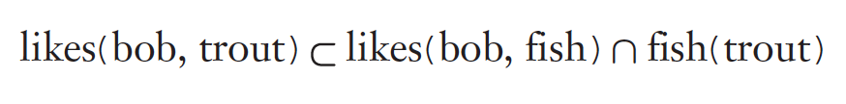
Example Clausal Forms
if bob likes fish and a trout is a fish, then bob likes trout.
if al is bob’s father and violet is bob’s mother and
louis is bob’s grandfather, then
louis is either al’s father or violet’s father

Slide 13
Predicate Calculus and Proving Theorems
A use of propositions is to discover new theorems that can be inferred from known axioms and theorems
Resolution: an inference principle that allows inferred propositions to be computed from given propositions

Slide 14



Concept of Resolution
Suppose there are two propositions of the form:
Suppose P1 is identical to Q2
We can write

Slide 15

Concept of Resolution
The mechanics:
Terms of the left sides are OR’d
Terms of the right sides are AND’d.
Any term that appears on both sides is removed.

Slide 16
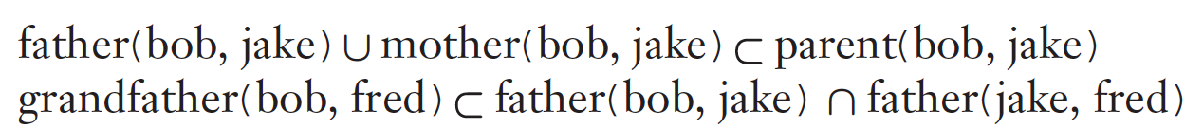

Concept of Resolution
The mechanics:
Terms of the left sides are OR’d
Terms of the right sides are AND’d.
Any term that appears on both sides is removed.

Slide 17
Resolution
Unification: finding values for variables in propositions that allows matching process to succeed
Instantiation: assigning temporary values to variables to allow unification to succeed
After instantiating a variable with a value, if matching fails, may need to backtrack and instantiate with a different value

Slide 18
Proof by Contradiction
Hypotheses: a set of pertinent propositions
Goal: negation of theorem stated as a proposition
Theorem is proved by finding an inconsistency

Slide 19
Theorem Proving
Basis for logic programming
When propositions used for resolution, only restricted form can be used
Horn clause - can have only two forms
  Headed: single atomic proposition on left side
  Headless: empty left side (used to state facts)
Most propositions can be stated as Horn clauses

Slide 20
Overview of Logic Programming
Declarative semantics
  There is a simple way to determine the meaning of each statement
  Simpler than the semantics of imperative languages
Programming is nonprocedural
  Programs do not state now a result is to be computed, but rather the form of the result
  Programming in both imperative and functional languages is procedural, which means that the programmer instructs the computer on exactly how the computation is to be done.

Slide 21
Example: Sorting a List
Describe the characteristics of a sorted list, not the process of rearranging a list
sort(old_list, new_list) ⊂ permute (old_list, new_list) ∩ sorted (new_list)
sorted (list) ⊂ ∀_{j} such that 1≤ j < n, list(j) ≤ list (j+1)

Slide 22
The Origins of Prolog
University of Aix-Marseille (Calmerauer & Roussel)
  Natural language processing
University of Edinburgh (Kowalski)
  Automated theorem proving

Slide 23
Terms
This book uses the Edinburgh syntax of Prolog
Term: a constant, variable, or structure
Constant: an atom or an integer
Atom: symbolic value of Prolog
Atom consists of either:
  a string of letters, digits, and underscores beginning with a lowercase letter
  a string of printable ASCII characters delimited by apostrophes

Slide 24
Terms: Variables and Structures
Variable: any string of letters, digits, and underscores beginning with an uppercase letter
Instantiation: binding of a variable to a value
  Lasts only as long as it takes to satisfy one complete goal
Structure: represents atomic proposition
  functor(parameter list)

Slide 25
Fact Statements
Used for the hypotheses
Headless Horn clauses
female(shelley).
male(bill).
father(bill, jake).
father(bill, shelley).
mother(mary, jake).
mother(mary, shelley).
Notice that every Prolog statement is terminated by a period.

Slide 26
Rule Statements
Used for the hypotheses
Headed Horn clause
Right side: antecedent (if part)
  May be single term or conjunction
Left side: consequent (then part)
  Must be single term
Conjunction: multiple terms separated by logical AND operations (implied)
female(shelley), child(shelley).

Slide 27
Rule Statements
The general form of the Prolog headed Horn clause statement is
consequence :- antecedent_expression.
“consequence can be concluded if the antecedent expression is true or can be made to be true by some instantiation of its variables.”

Slide 28
Example Rules
ancestor(mary,shelley):- mother(mary,shelley).
Can use variables (universal objects) to generalize meaning:
parent(X,Y):- mother(X,Y).
parent(X,Y):- father(X,Y).
grandparent(X,Z):- parent(X,Y), parent(Y,Z).
Here X, Y, Z are variables (they start with uppercase letters)

Slide 29
Goal Statements
For theorem proving, theorem is in form of proposition that we want system to prove or disprove – goal statement
Same format as headless Horn
man(fred)
Conjunctive propositions and propositions with variables also legal goals
father(X, mike)

Slide 30
Inferencing Process of Prolog
Queries are called goals
If a goal is a compound proposition, each of the facts is a subgoal
To prove a goal is true, must find a chain of inference rules and/or facts. For goal Q:
  P₂ :- P₁
  P₃ :- P₂
  …
  Q :- P_{n}
Process of proving a subgoal called matching, satisfying, or resolution

Slide 31
Approaches
Matching is the process of proving a proposition
Proving a subgoal is called satisfying the subgoal
Bottom-up resolution, forward chaining
  Begin with facts and rules of database and attempt to find sequence that leads to goal
  Works well with a large set of possibly correct answers
Top-down resolution, backward chaining
  Begin with goal and attempt to find sequence that leads to set of facts in database
  Works well with a small set of possibly correct answers
Prolog implementations use backward chaining

Slide 32
Subgoal Strategies
When goal has more than one subgoal, can use either
  Depth-first search: find a complete proof for the first subgoal before working on others
  Breadth-first search: work on all subgoals in parallel
Prolog uses depth-first search
  Can be done with fewer computer resources

Slide 33
Backtracking
With a goal with multiple subgoals, if fail to show truth of one of subgoals, reconsider previous subgoal to find an alternative solution: backtracking
Begin search where previous search left off
Can take lots of time and space because may find all possible proofs to every subgoal

Slide 34
Simple Arithmetic
Prolog supports integer variables and integer arithmetic
is operator: takes an arithmetic expression as right operand and variable as left operand
A is B / 17 + C
Not the same as an assignment statement!
  The following is illegal (Left side variable cannot be previously instantiated)
Sum is Sum + Number.

Slide 35
Example
speed(ford,100).
speed(chevy,105).
speed(dodge,95).
speed(volvo,80).
time(ford,20).
time(chevy,21).
time(dodge,24).
time(volvo,24).
distance(X,Y) :- speed(X,Speed),
time(X,Time),
Y is Speed * Time.
A query: distance(chevy, Chevy_Distance).

Slide 36
Trace
Built-in structure that displays instantiations at each step
Tracing model of execution - four events:
  Call (beginning of attempt to satisfy goal)
  Exit (when a goal has been satisfied)
  Redo (when backtrack occurs)
  Fail (when goal fails)

Slide 37
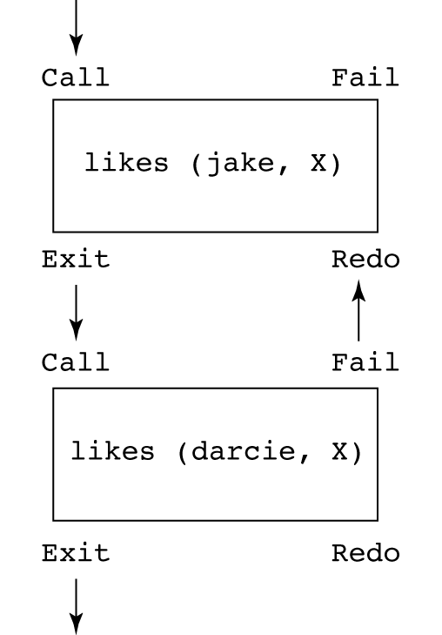
Example
likes(jake,chocolate).
likes(jake, apricots).
likes(darcie, licorice).
likes(darcie, apricots).
trace.
likes(jake, X), likes(darcie, X).
1 Call: likes(jake, _0)?
(1) 1 Exit: likes(jake, chocolate)
(2) 1 Call: likes(darcie, chocolate)?
(2) 1 Fail: likes(darcie, chocolate)
1 Redo: likes(jake, _0)?
(1) 1 Exit: likes(jake, apricots)
(3) 1 Call: likes(darcie, apricots)?
(3) 1 Exit: likes(darcie, apricots)
X = apricots

Slide 38
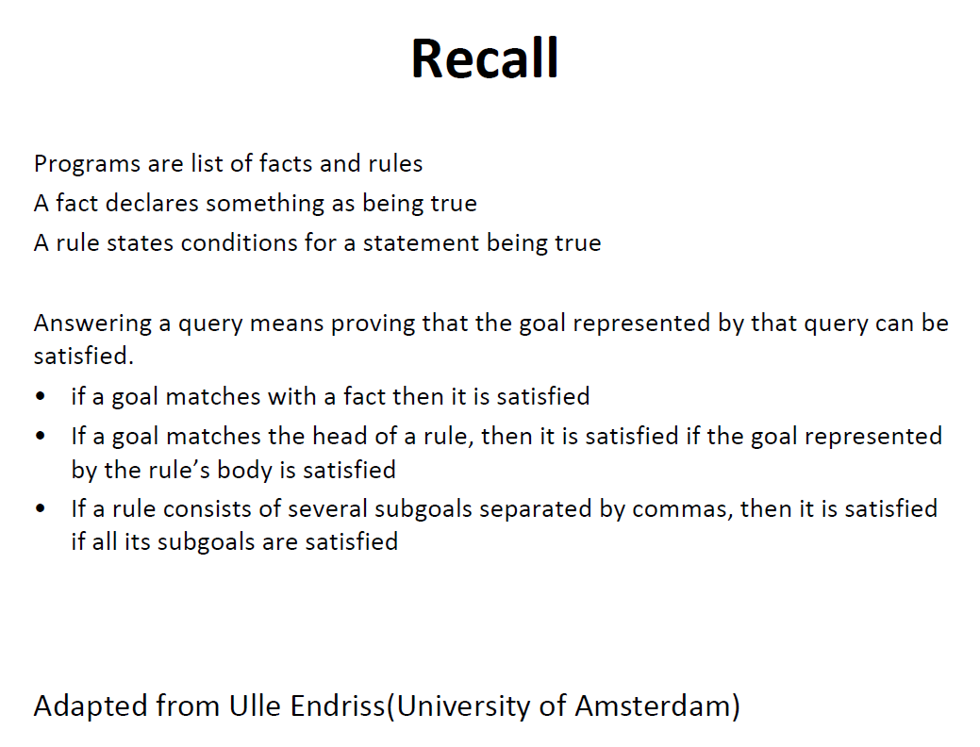

Slide 39
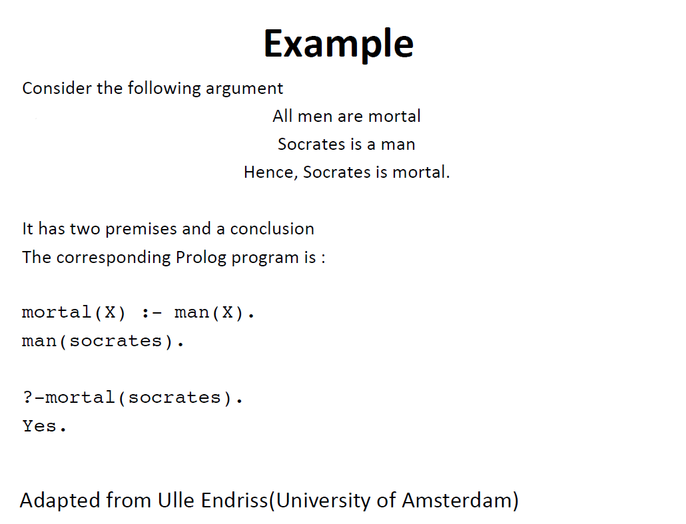

Slide 40
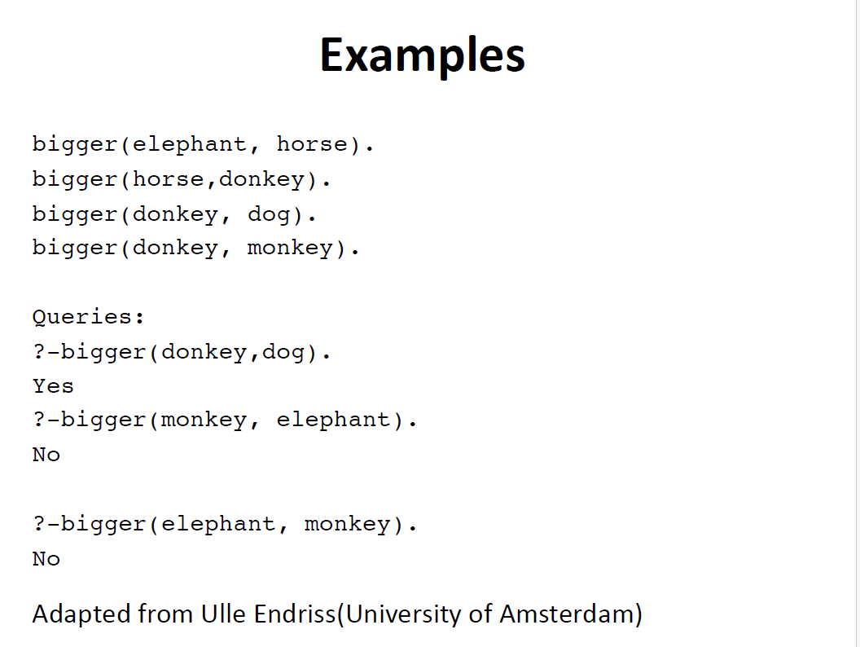

Slide 41
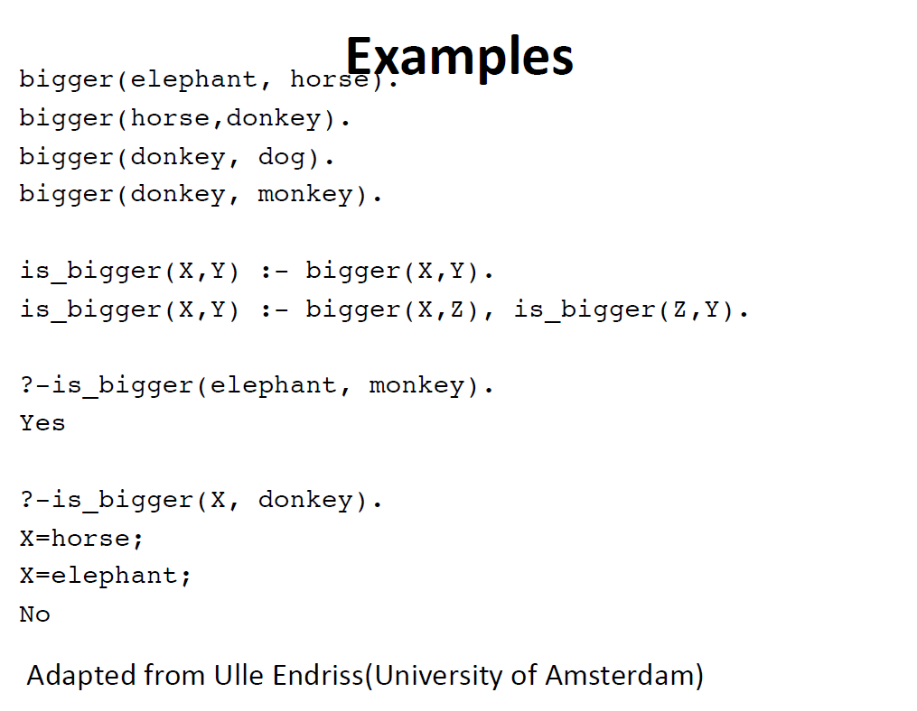

Slide 42
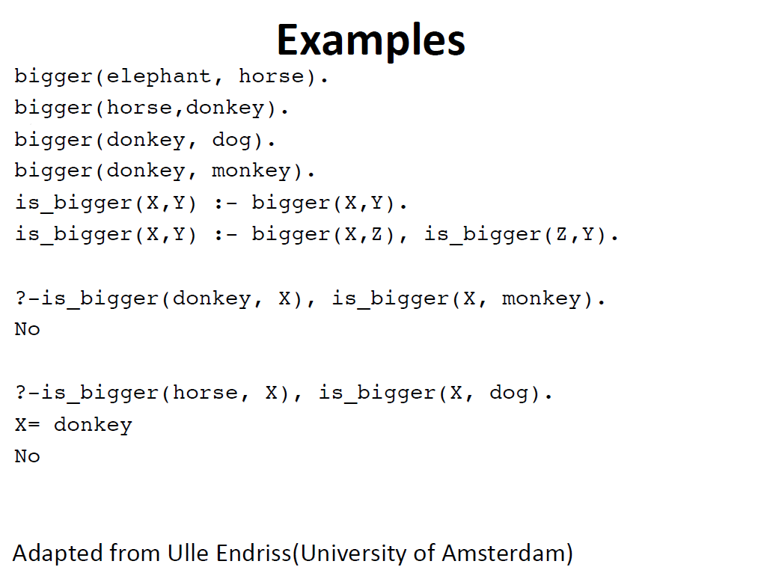

Slide 43
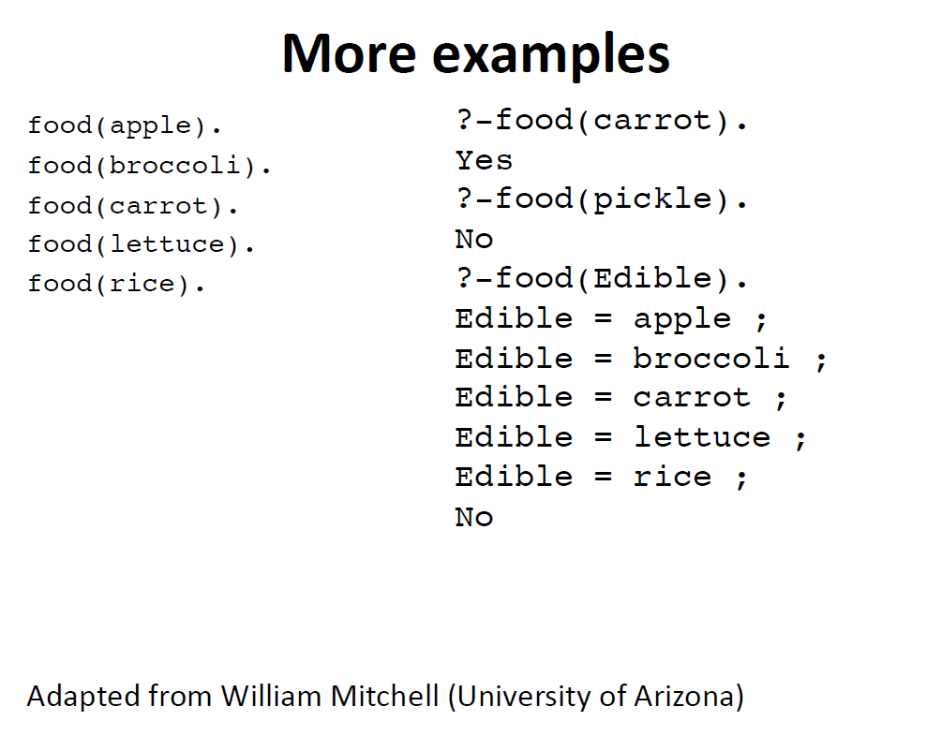

Slide 44
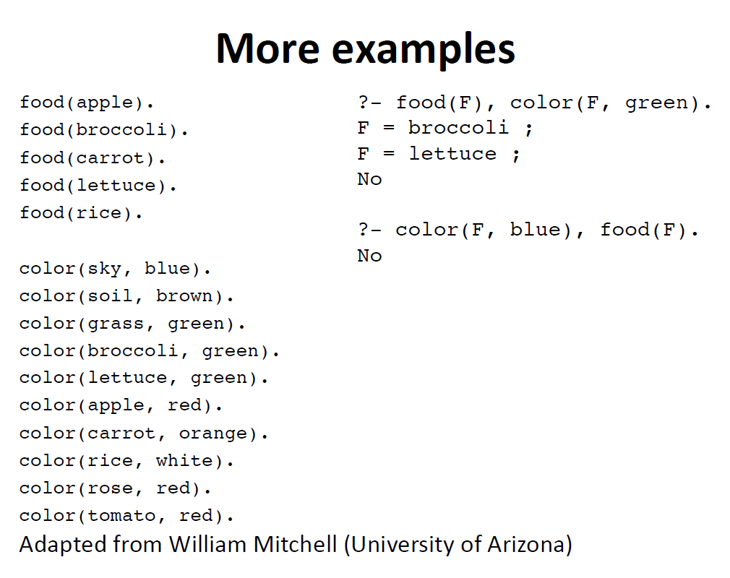

Slide 45
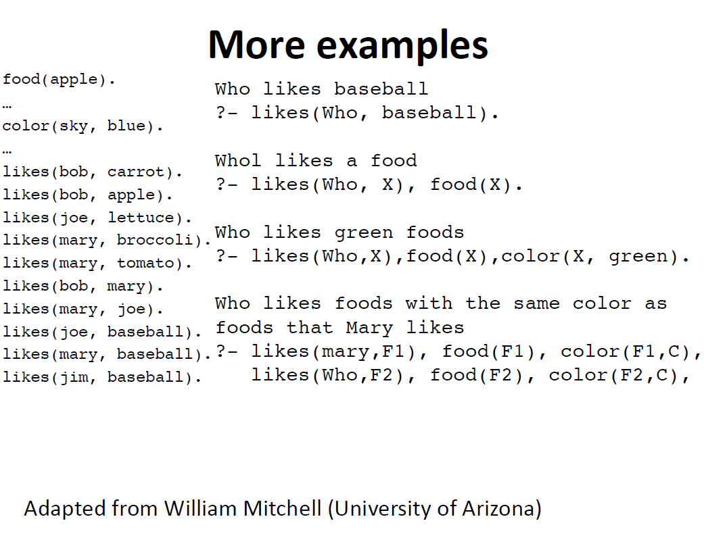

Slide 46
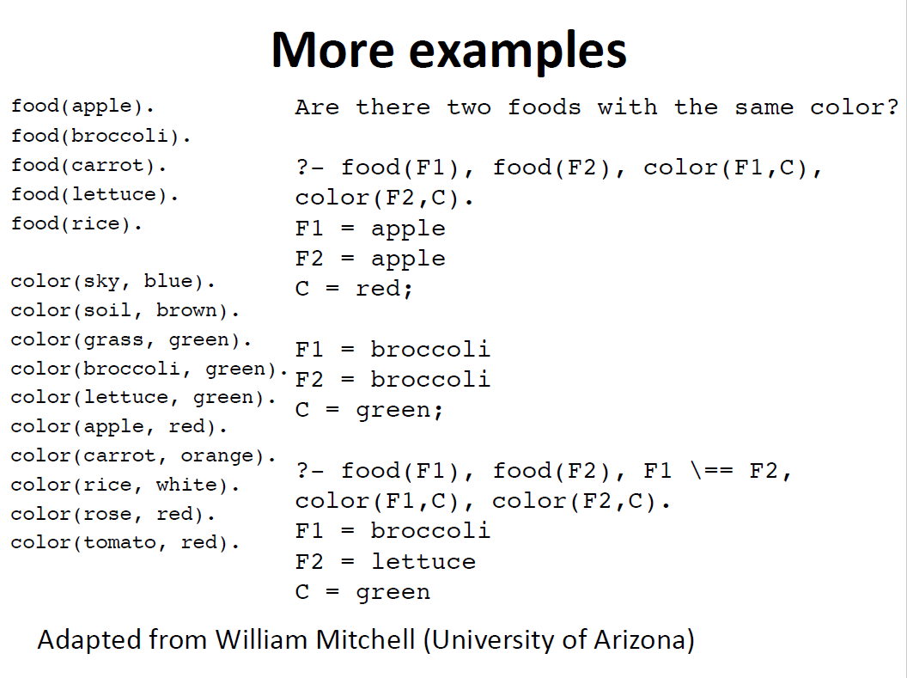

Slide 47
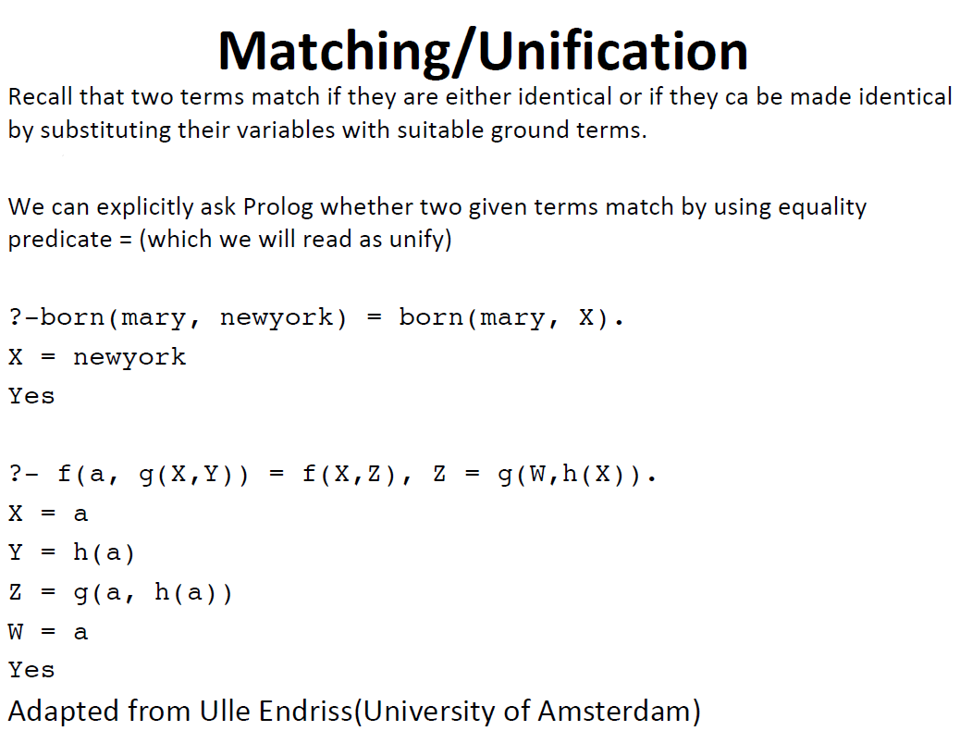

Slide 48
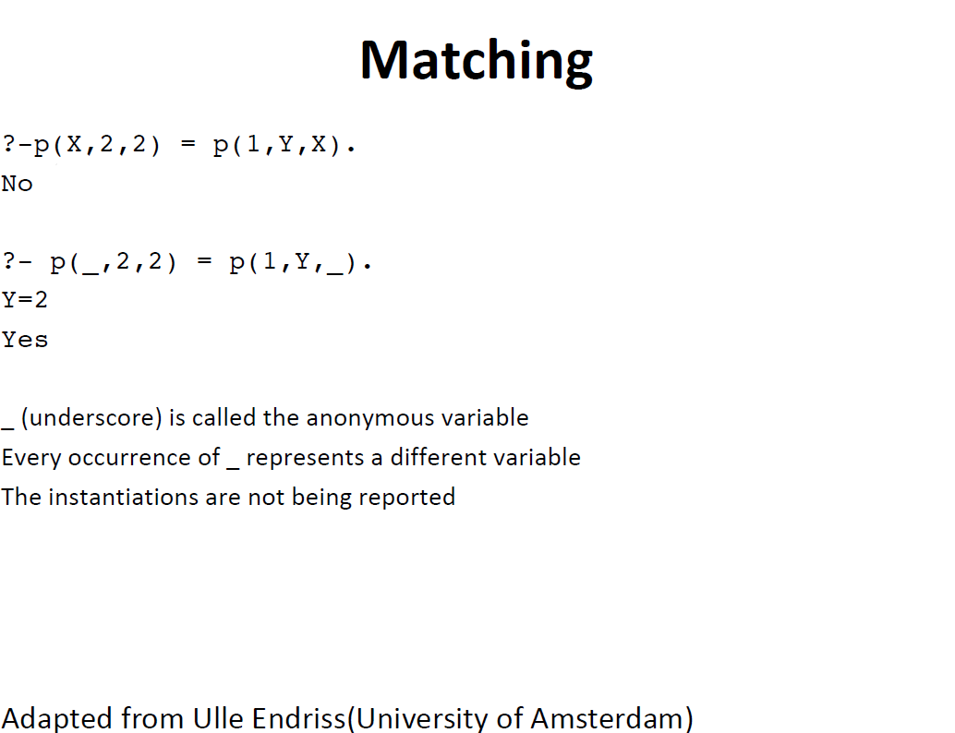

Slide 49
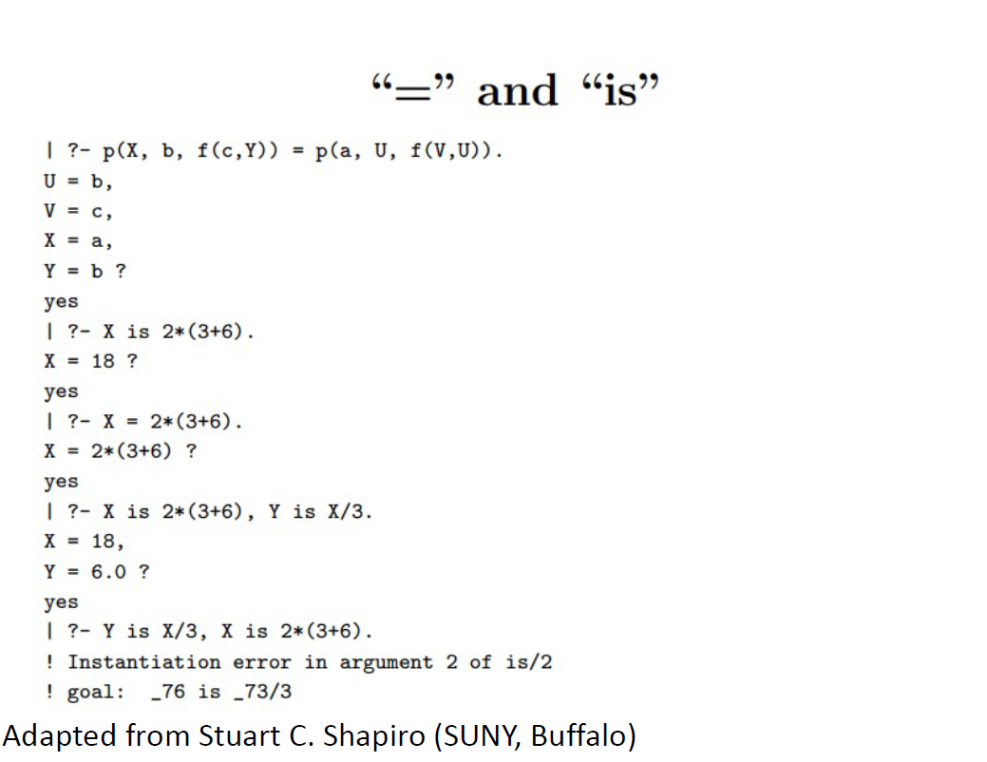

Slide 50
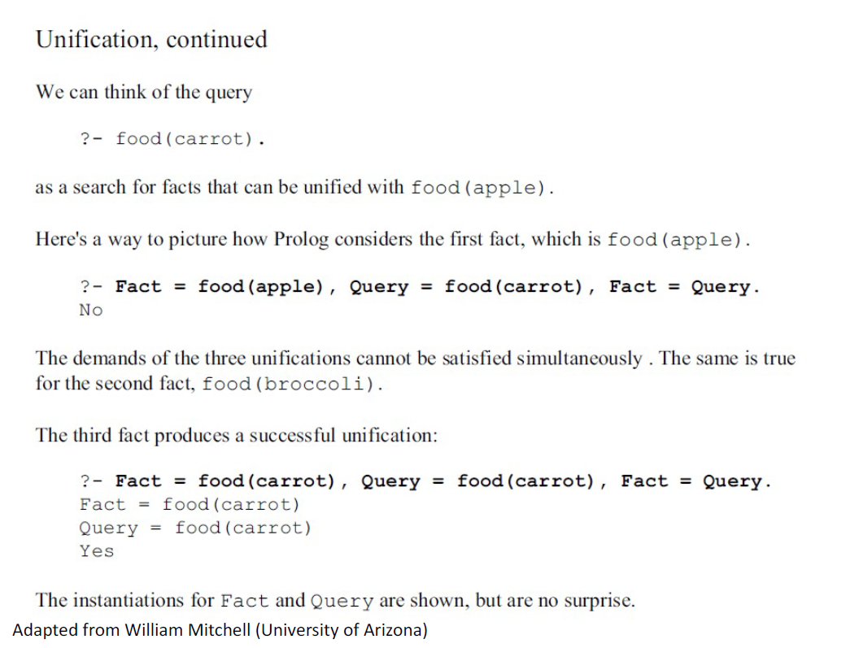

Slide 51
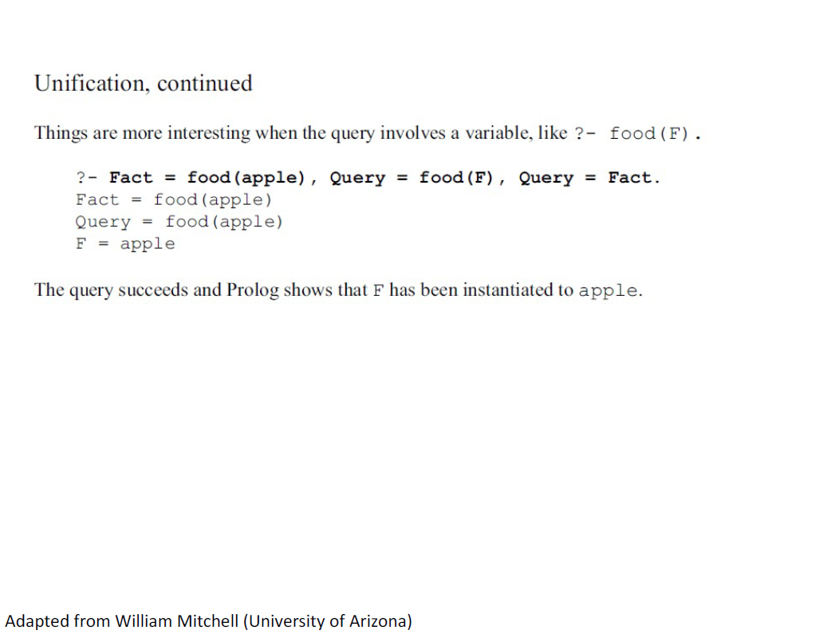

Slide 52
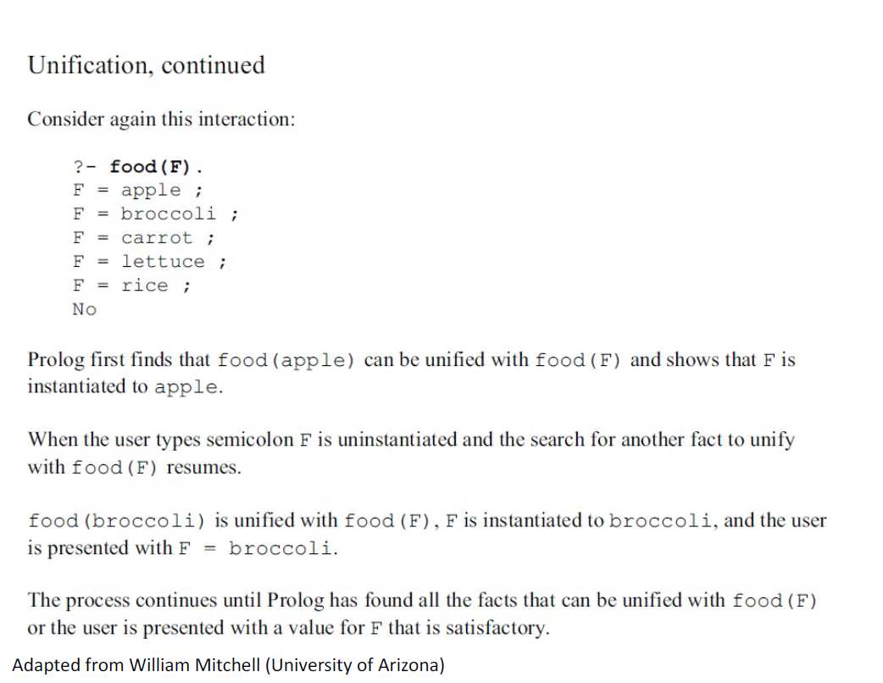

Slide 53
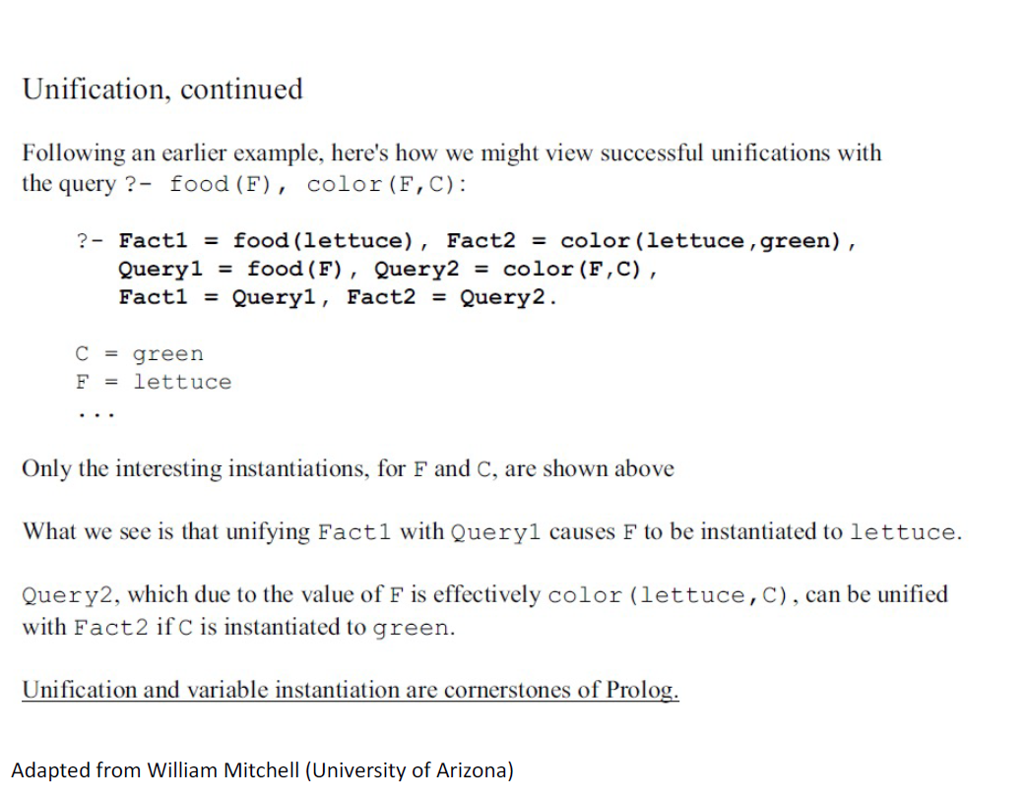

Slide 54
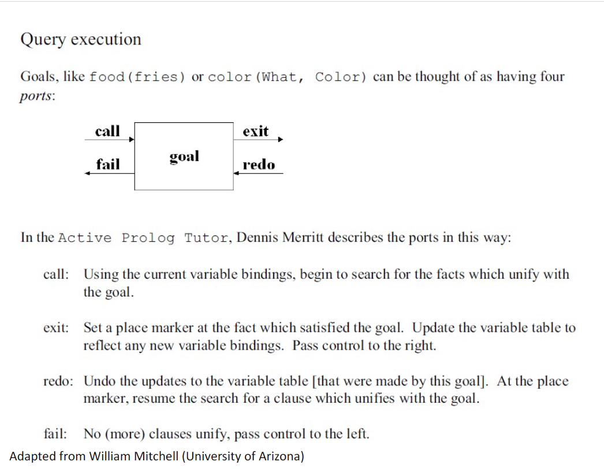

Slide 55
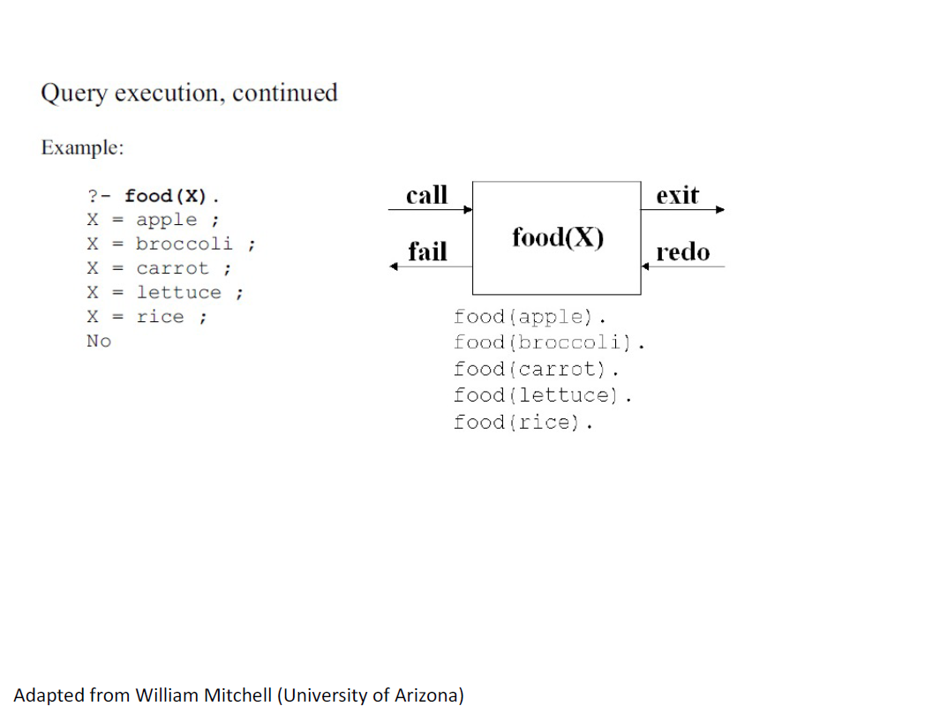

Slide 57
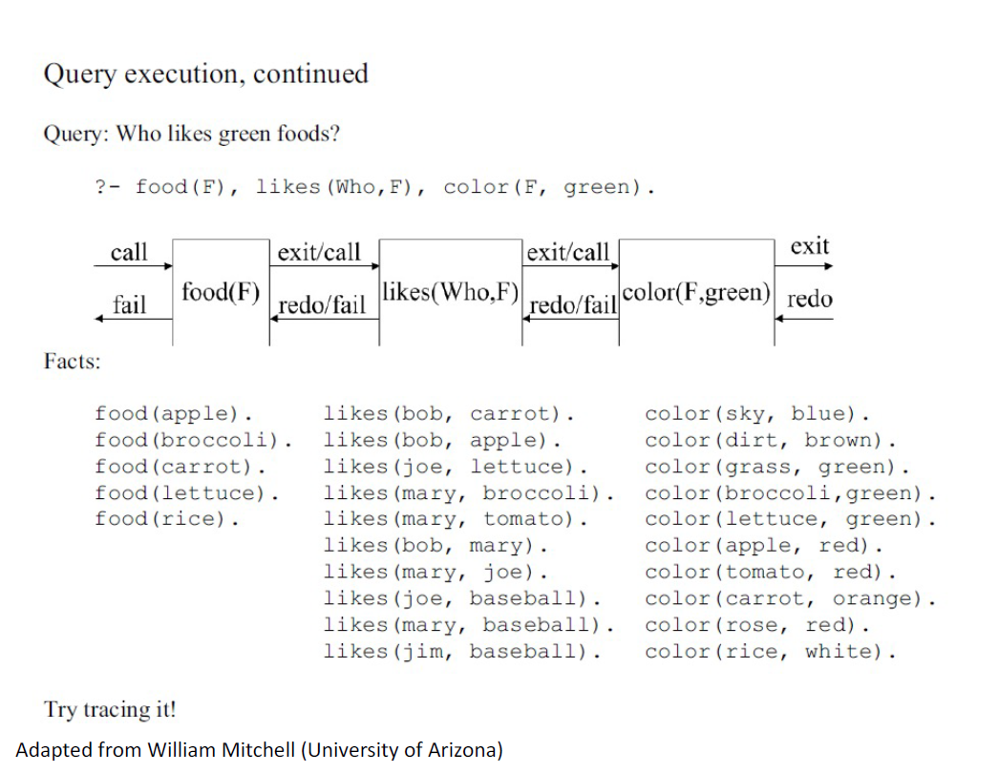

Slide 58
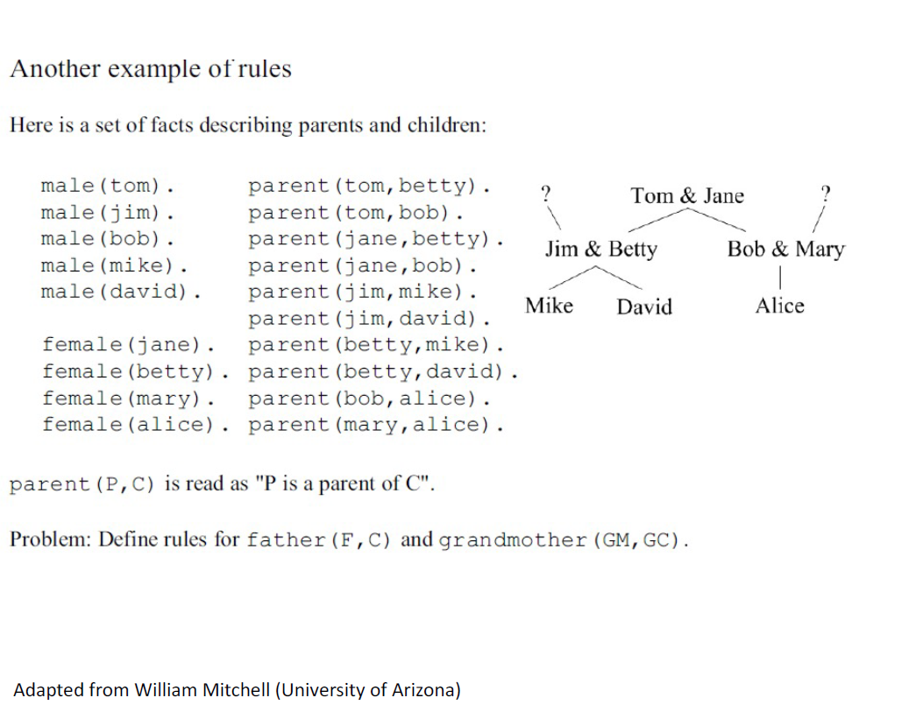

Slide 59
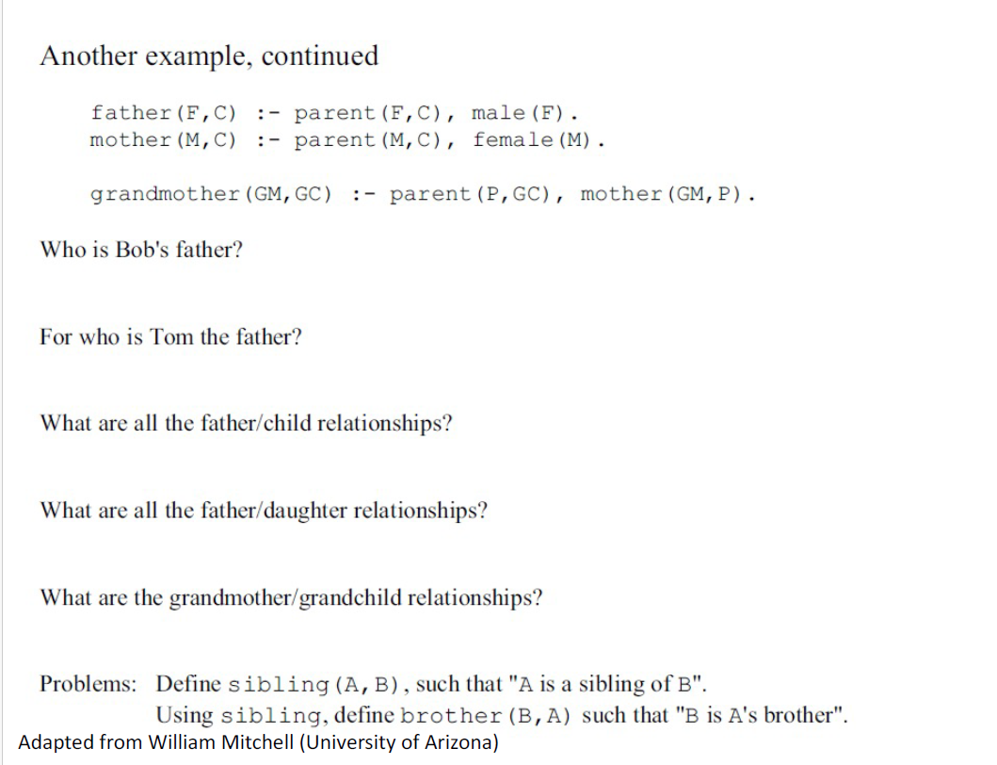

Slide 60
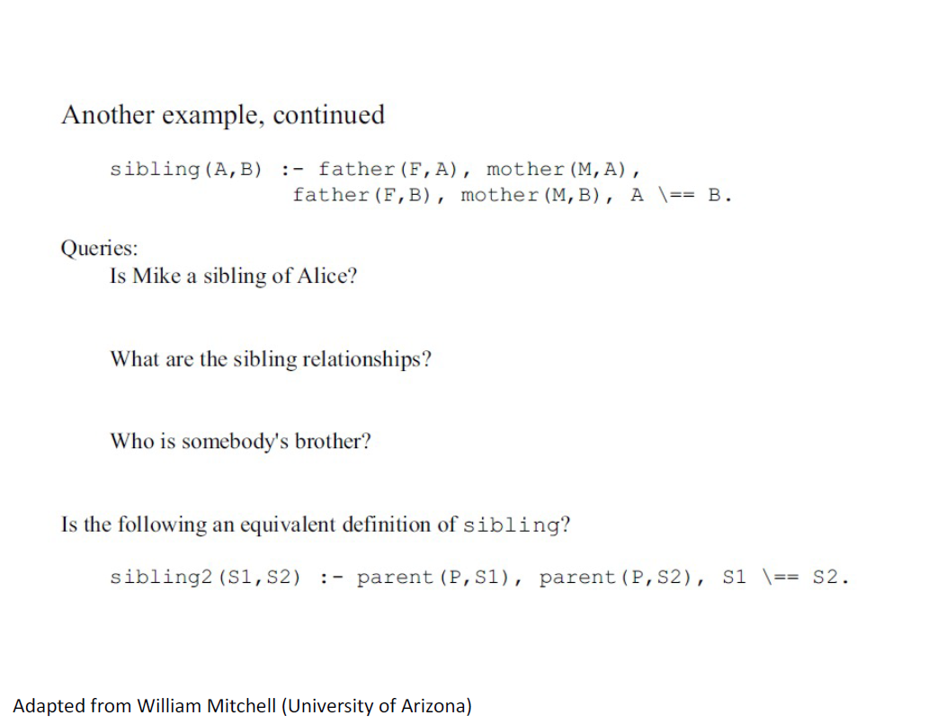

Slide 61
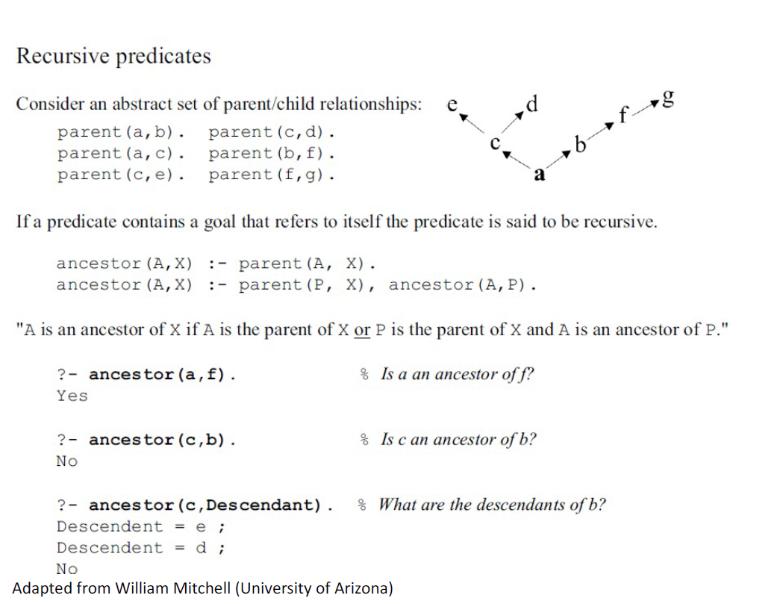

Slide 62
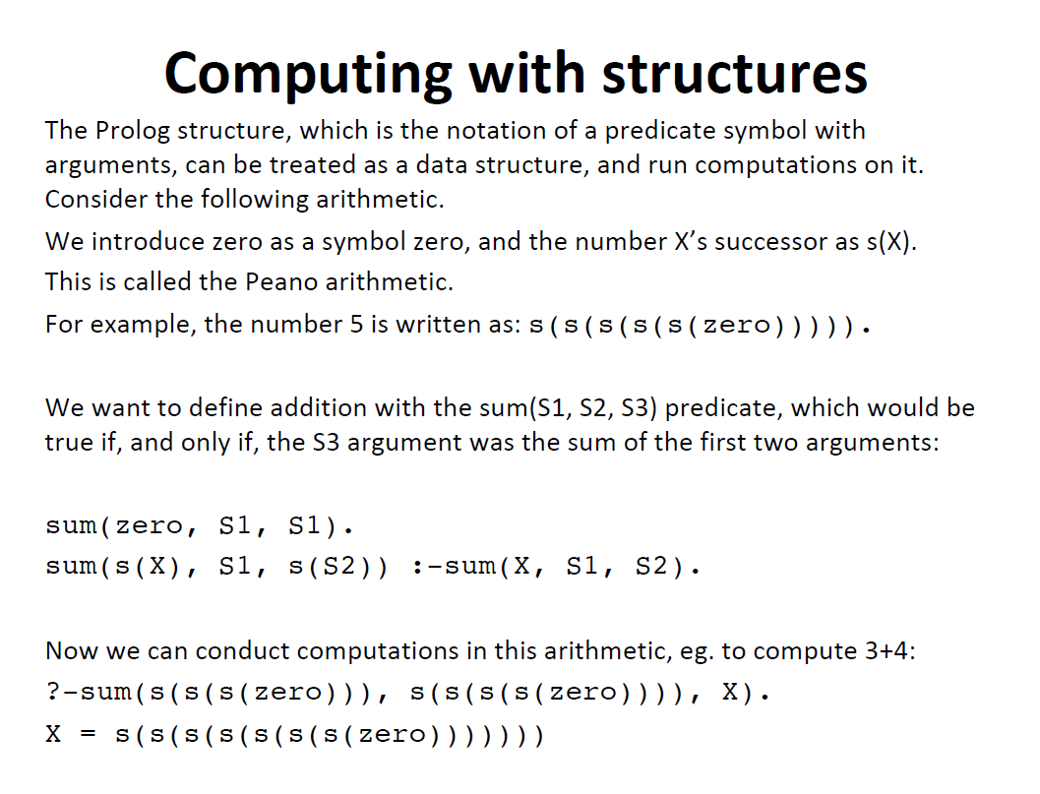

Slide 63
List Structures
Other basic data structure (besides atomic propositions we have already seen): list
List is a sequence of any number of elements
Elements can be atoms, atomic propositions, or other terms (including other lists)
[apple, prune, grape, kumquat]
[] (empty list)
[X | Y] (head X and tail Y)

Slide 64
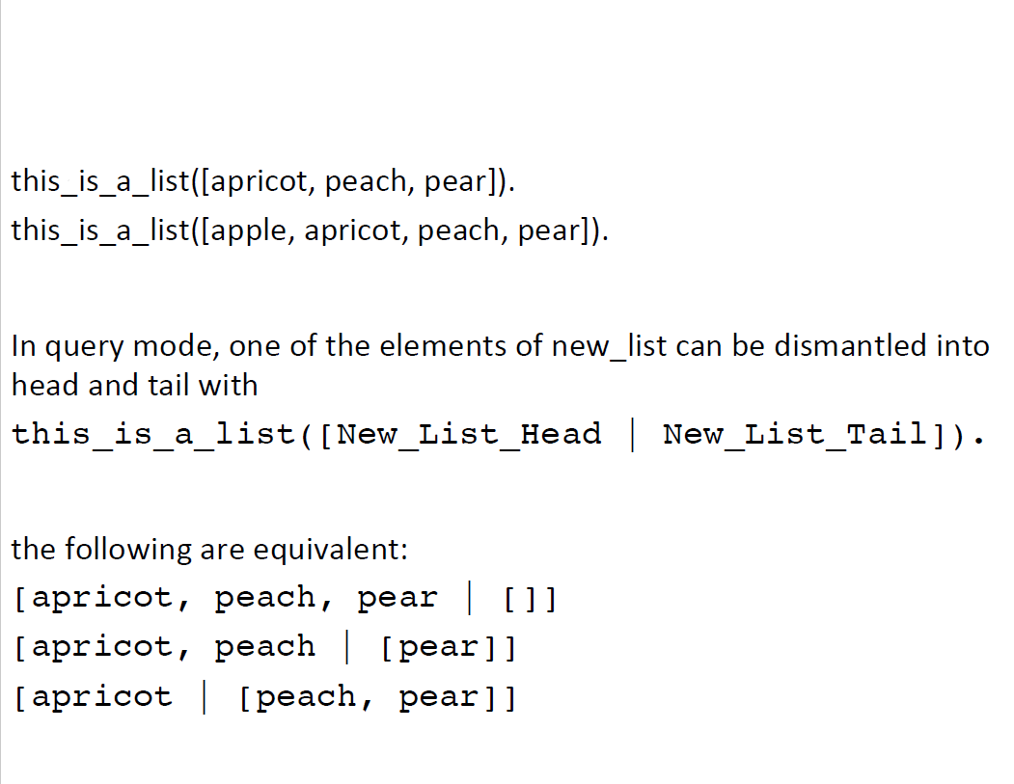

Slide 65
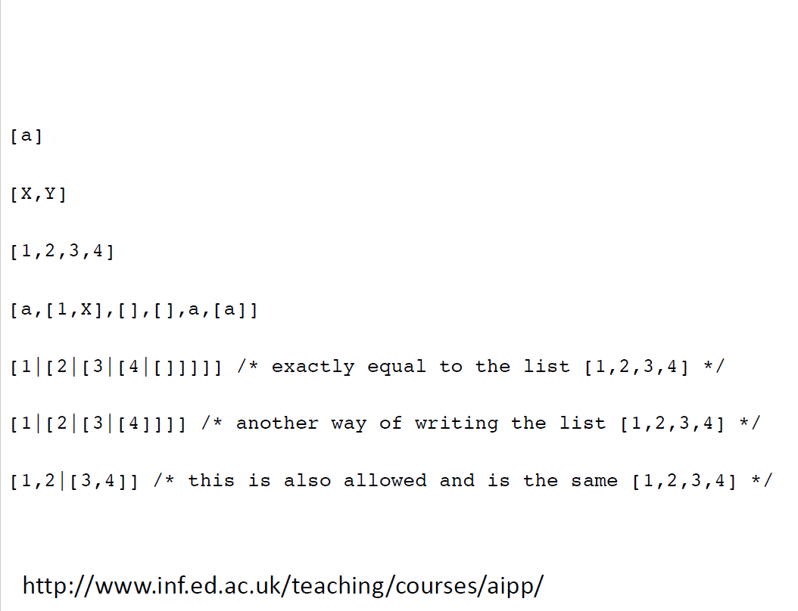

Slide 66
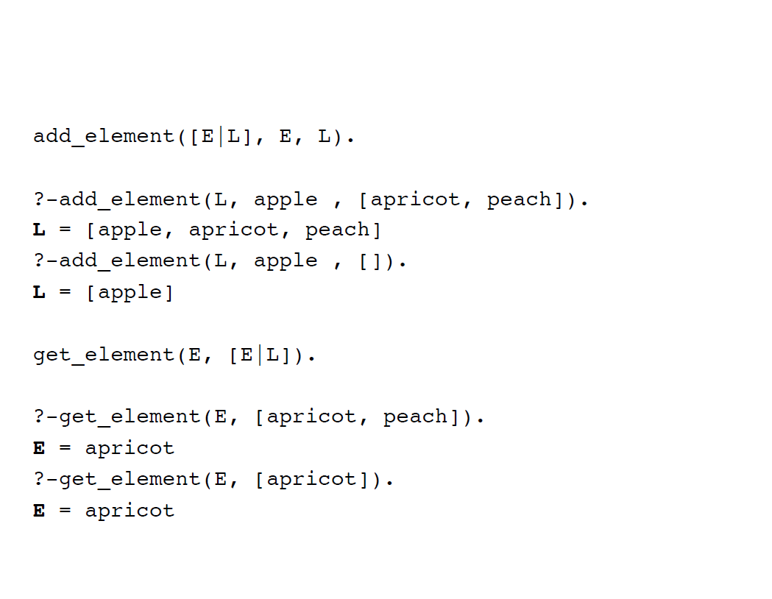

Slide 67
Append Example
append([], List, List).
append([Head | List_1], List_2, [Head | List_3]) :-
append (List_1, List_2, List_3).

Slide 68
trace.
append([bob, jo], [jake, darcie], Family).
(1) 1 Call: append([bob, jo], [jake, darcie], _10)?
(2) 2 Call: append([jo], [jake, darcie], _18)?
(3) 3 Call: append([], [jake, darcie], _25)?
(3) 3 Exit: append([], [jake, darcie], [jake, darcie])
(2) 2 Exit: append([jo], [jake, darcie], [jo, jake, darcie])
(1) 1 Exit: append([bob, jo], [jake, darcie],
[bob, jo, jake, darcie])
Family = [bob, jo, jake, darcie]
yes

Slide 69
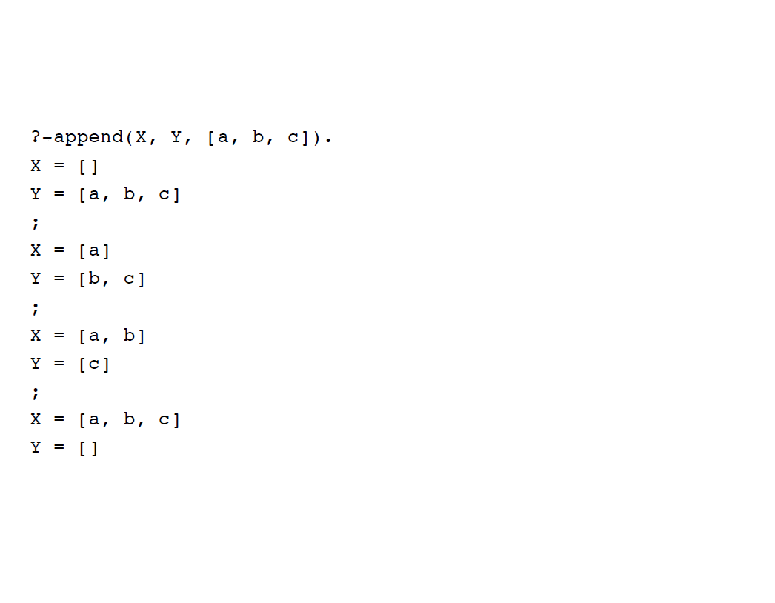

Slide 70
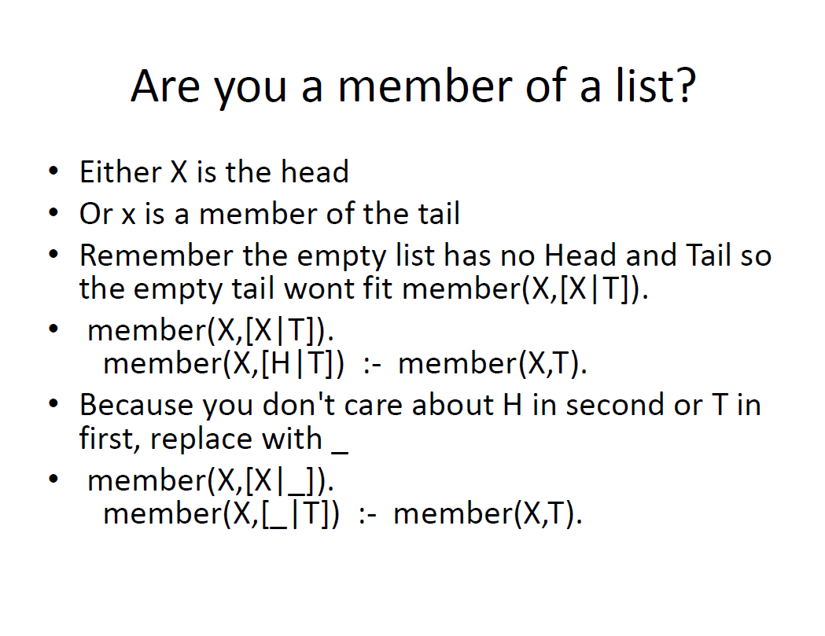

Slide 71
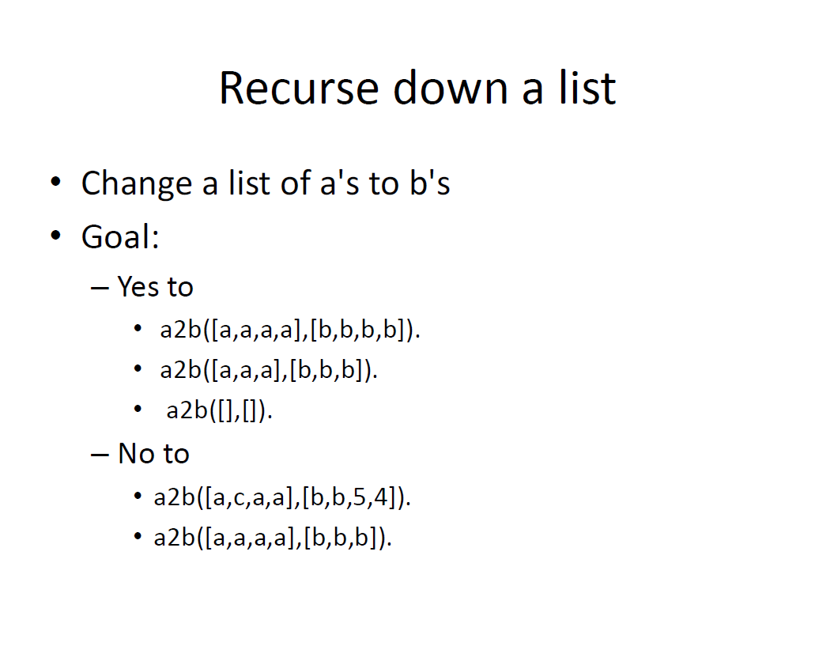

Slide 72
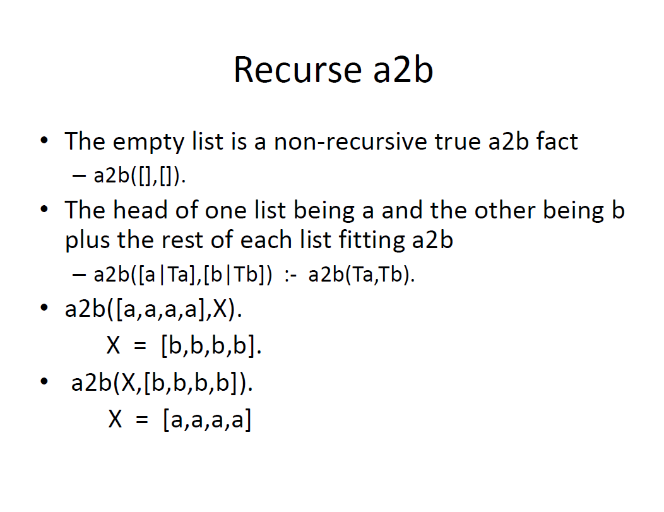

Slide 73
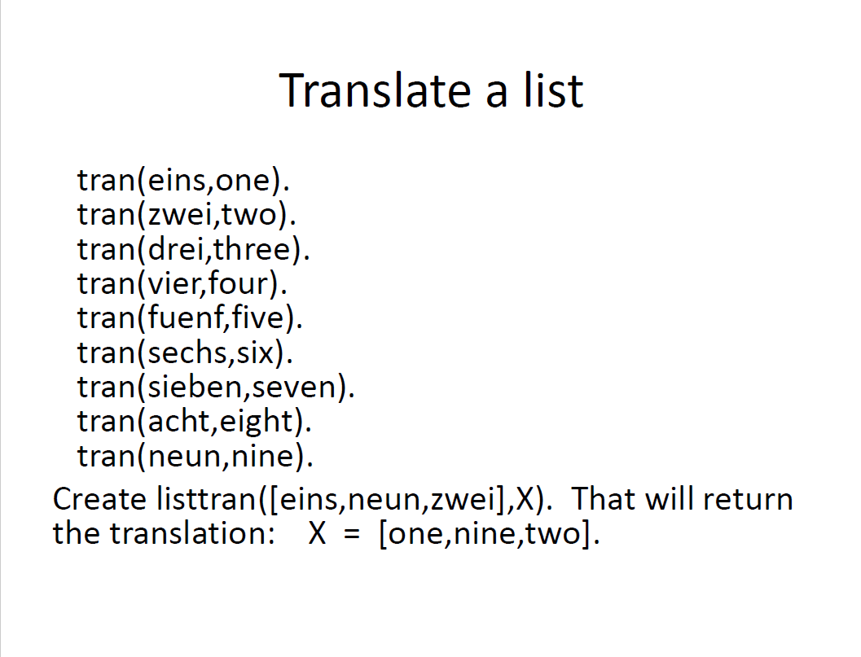

Slide 74
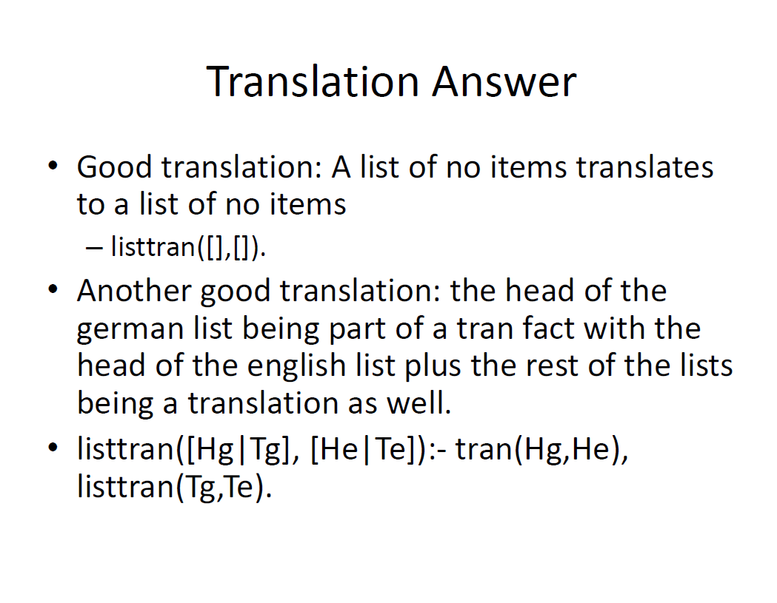

Slide 75
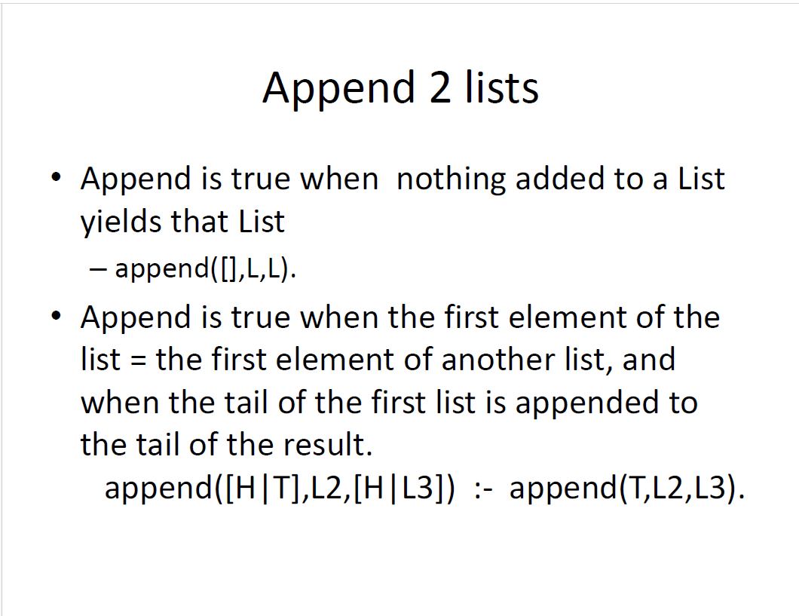

Slide 76
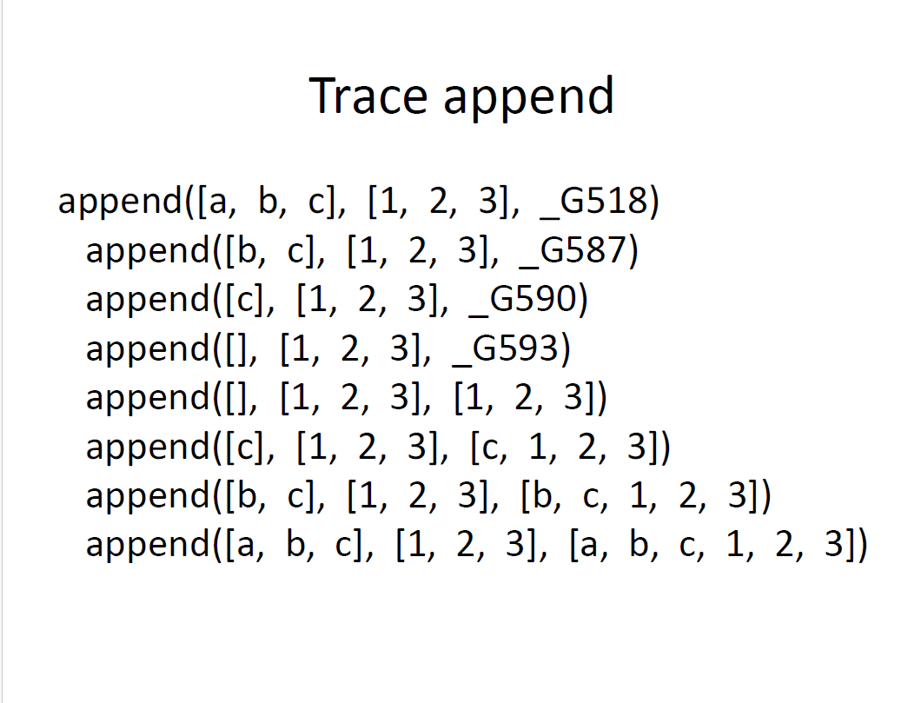

Slide 77
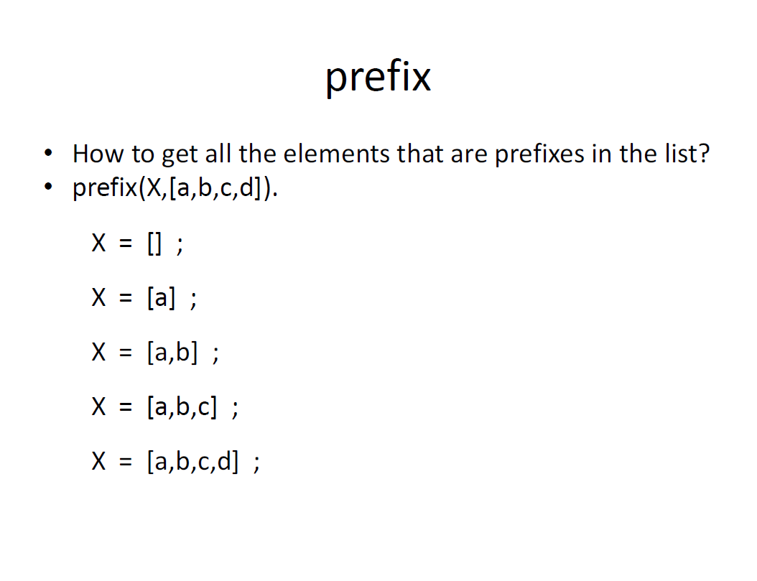

Slide 78
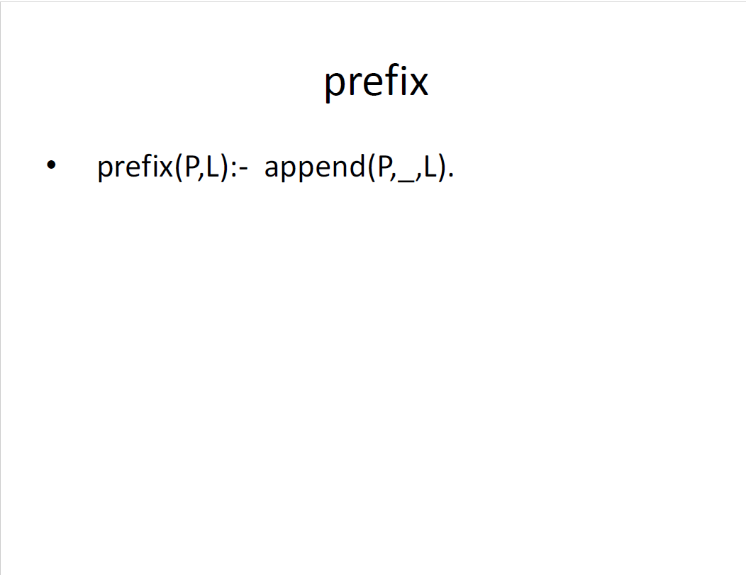

Slide 79
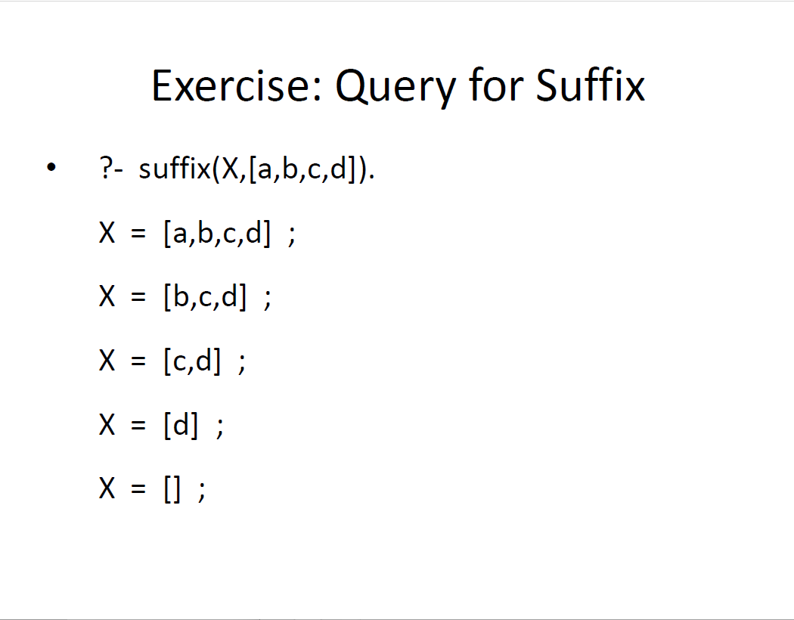

Slide 80
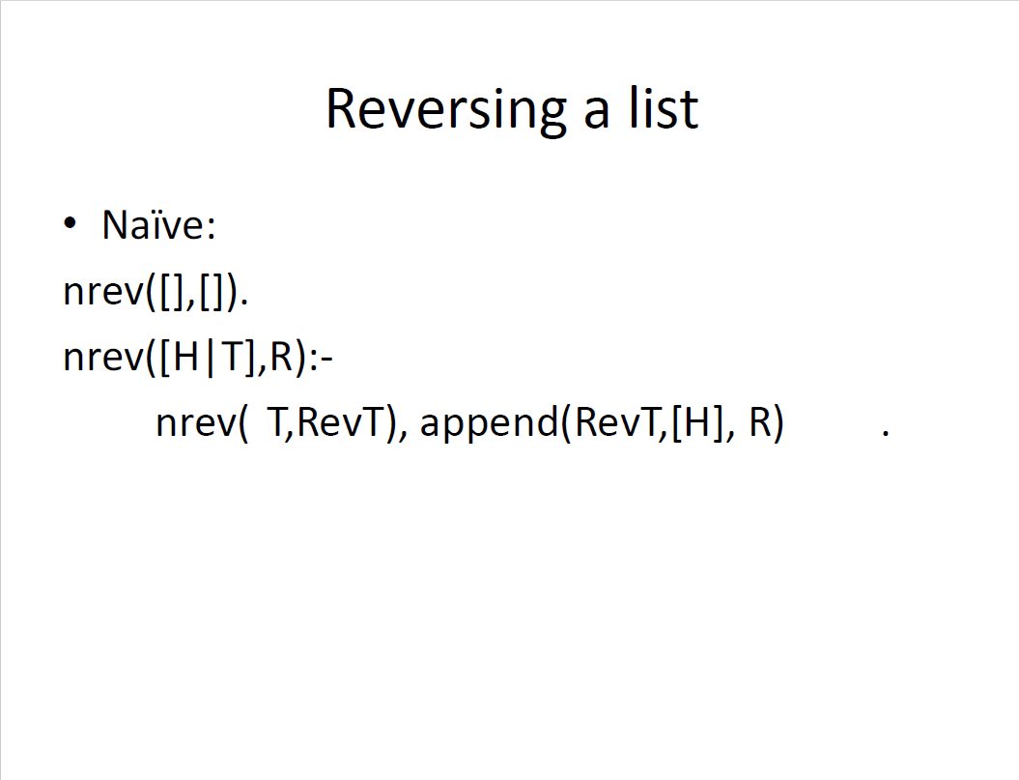

Slide 81
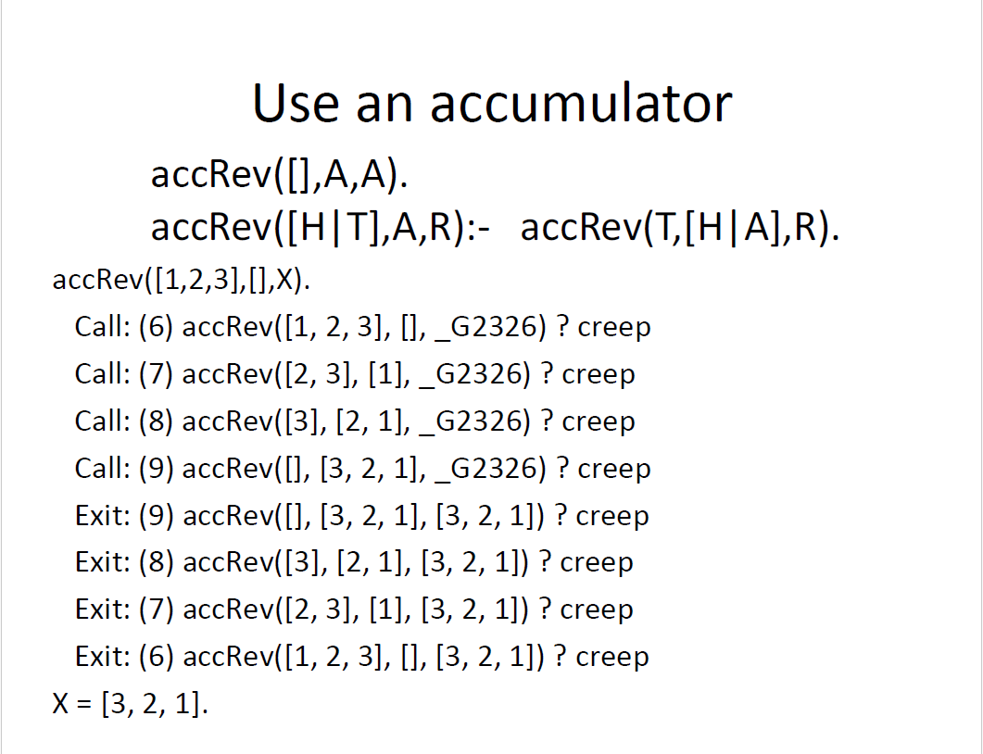

Slide 82
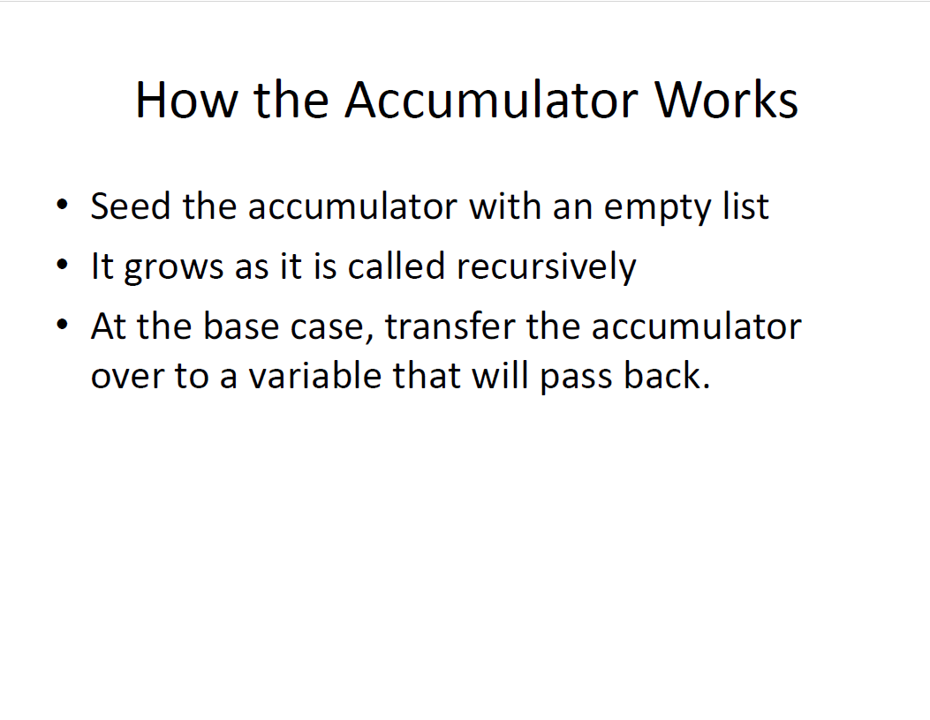

Slide 83
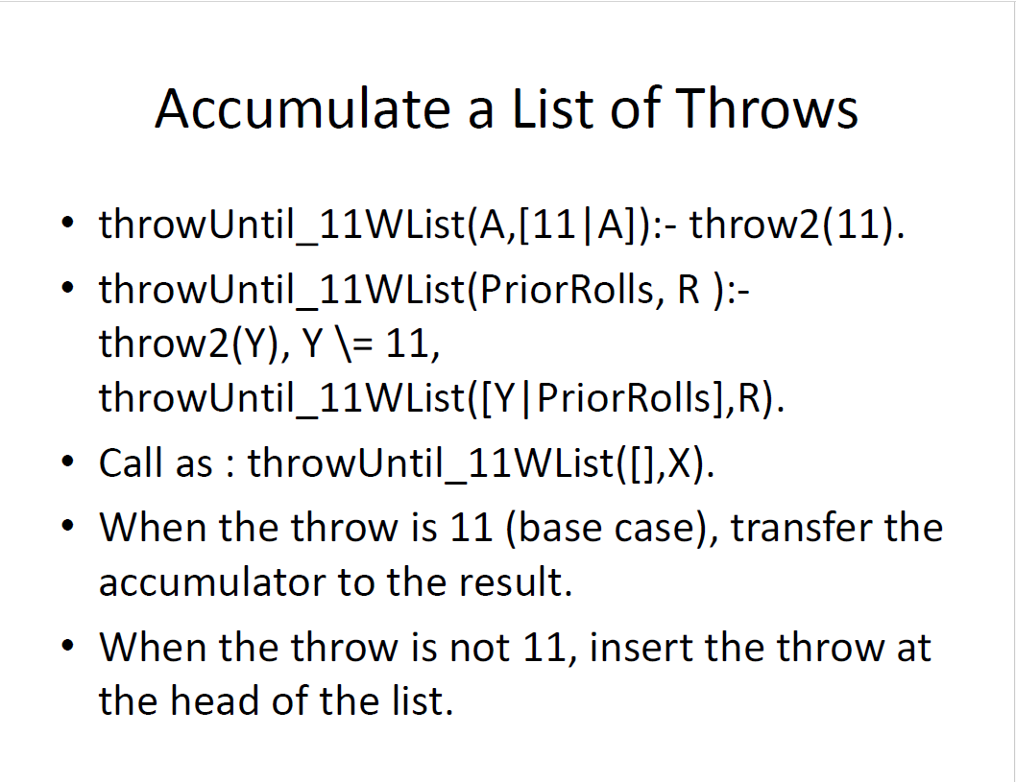

Slide 84
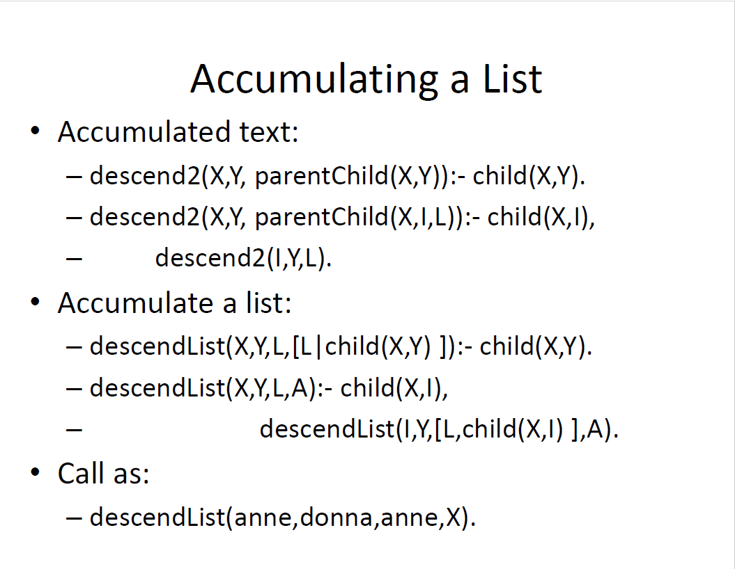

Slide 85
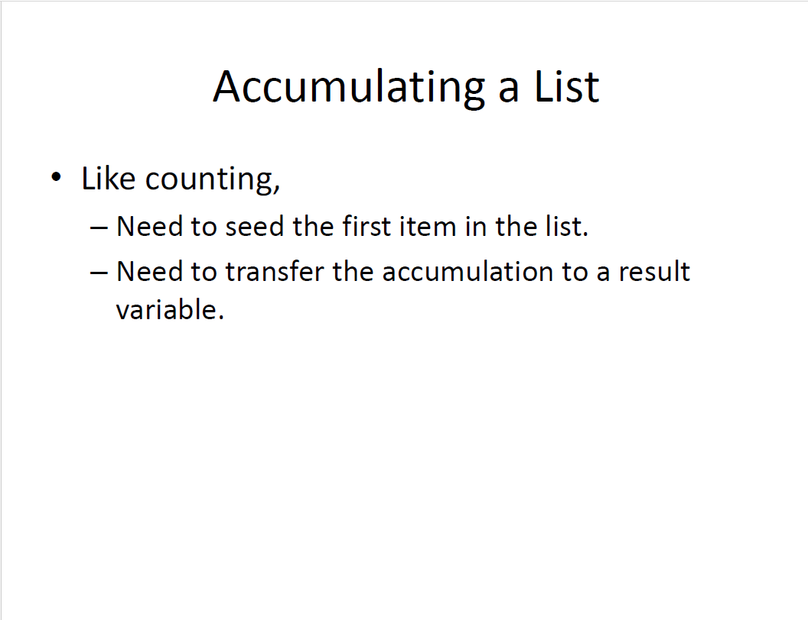

Slide 86
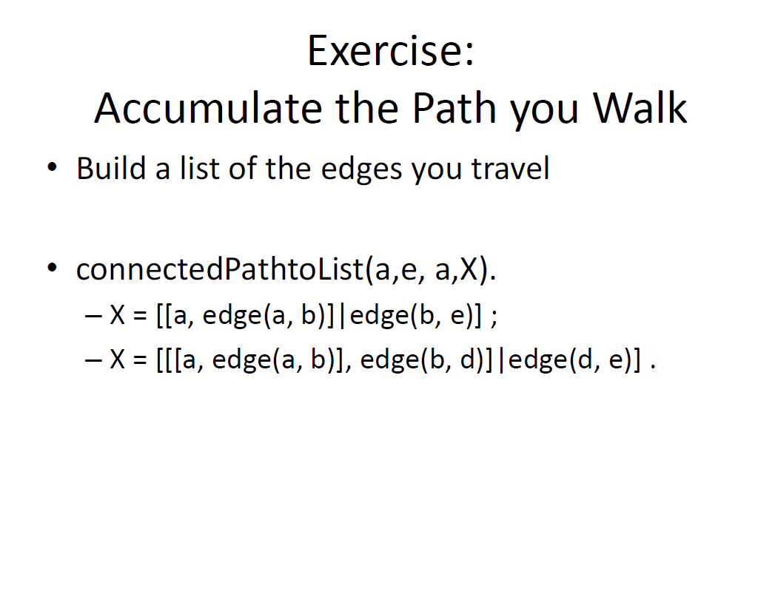

Slide 87
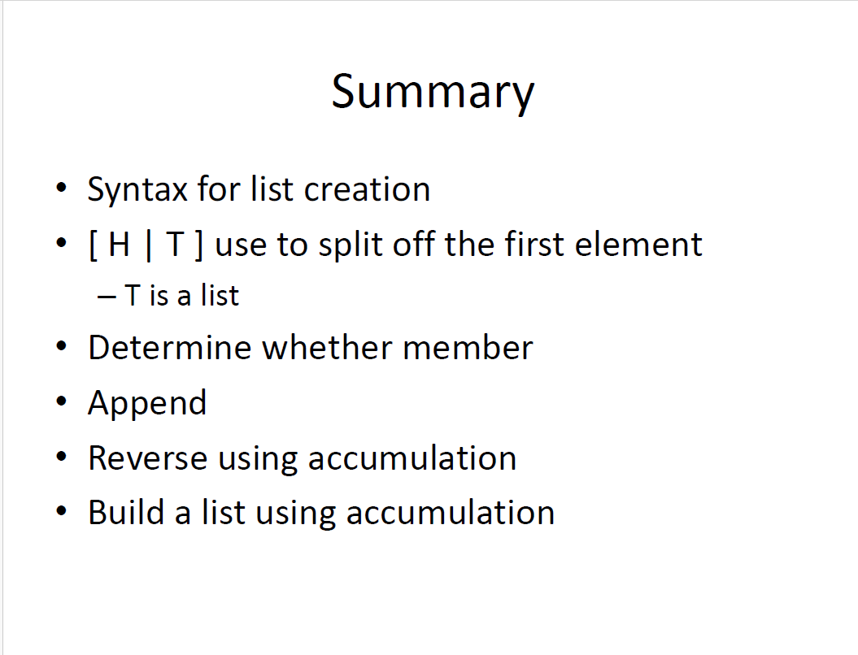

Slide 89
More Examples
reverse([], []).
reverse([Head | Tail], List) :-
reverse (Tail, Result),
append (Result, [Head], List).
member(Element, [Element | _]).
member(Element, [_ | List]) :-
member(Element, List).
The underscore character means an anonymous variable—it means we do not care what instantiation it might get from unification

Slide 90
trace.
reverse([a, b, c], Q).
(1) 1 Call: reverse([a, b, c], _6)?
(2) 2 Call: reverse([b, c], _65636)?
(3) 3 Call: reverse([c], _65646)?
(4) 4 Call: reverse([], _65656)?
(4) 4 Exit: reverse([], [])
(5) 4 Call: append([], [c], _65646)?
(5) 4 Exit: append([], [c], [c])
(3) 3 Exit: reverse([c], [c])
(6) 3 Call: append([c], [b], _65636)?
(7) 4 Call: append([], [b], _25)?
(7) 4 Exit: append([], [b], [b])
(6) 3 Exit: append([c], [b], [c, b])
(2) 2 Exit: reverse([b, c], [c, b])
(8) 2 Call: append([c, b], [a], _6)?
(9) 3 Call: append([b], [a], _32)?
(10) 4 Call: append([], [a], _39)?
(10) 4 Exit: append([], [a], [a])
(9) 3 Exit: append([b], [a], [b, a])
(8) 2 Exit: append([c, b], [a], [c, b, a])
(1) 1 Exit: reverse([a, b, c], [c, b, a])

Slide 91
trace.
member(a, [b, c, d]).
(1) 1 Call: member(a, [b, c, d])?
(2) 2 Call: member(a, [c, d])?
(3) 3 Call: member(a, [d])?
(4) 4 Call: member(a, [])?
(4) 4 Fail: member(a, [])
(3) 3 Fail: member(a, [d])
(2) 2 Fail: member(a, [c, d])
(1) 1 Fail: member(a, [b, c, d])
no
member(a, [b, a, c]).
(1) 1 Call: member(a, [b, a, c])?
(2) 2 Call: member(a, [a, c])?
(2) 2 Exit: member(a, [a, c])
(1) 1 Exit: member(a, [b, a, c])
yes

Slide 92
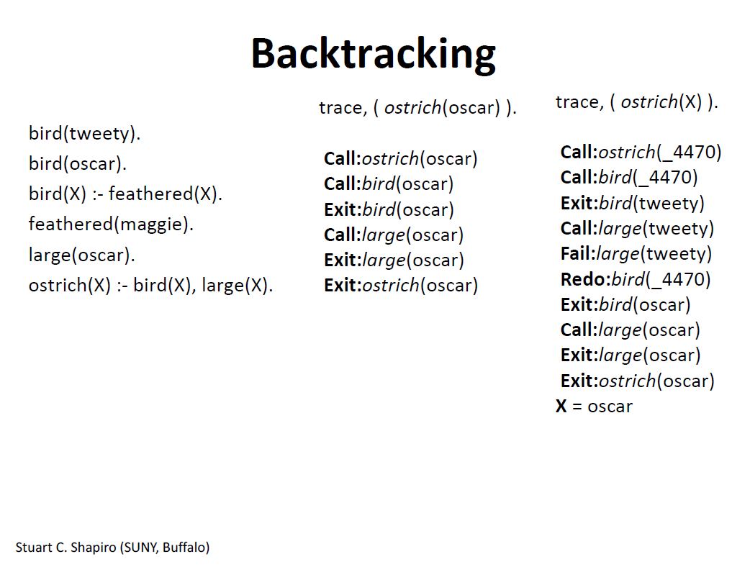

Slide 93
Deficiencies of Prolog
Resolution order control
  In a pure logic programming environment, the order of attempted matches is nondeterministic and all matches would be attempted concurrently
The closed-world assumption
  The only knowledge is what is in the database
The negation problem
  Anything not stated in the database is assumed to be false
Intrinsic limitations
  It is easy to state a sort process in logic, but difficult to actually do—it doesn’t know how to sort

Slide 94
Applications of Logic Programming
Relational database management systems
Expert systems
Natural language processing

Slide 95
Summary
Symbolic logic provides basis for logic programming
Logic programs should be nonprocedural
Prolog statements are facts, rules, or goals
Resolution is the primary activity of a Prolog interpreter
Although there are a number of drawbacks with the current state of logic programming it has been used in a number of areas

